Slide 1
DASHBOARDS WITH R
Databases to Dashboards
Lesson 6

Slide 2
LESSON OBJECTIVES
Format a flexdashboard to improve display of multiple plots
Add interactivity to plot and table components of flexdashboards

Slide 3
TYPICAL DATA SCIENCE PIPELINE
From R for Data Science (https://r4ds.had.co.nz/introduction.html)
Notes:
We refer to R for Data Science, a free text available online frequently
Provide a nice model for the typical process of analyzing data to communicate
Focus for this hour is the machinery that allows us to capture this whole process in a way that is reproducible and also can communicate to others

Slide 4
FROM R MARKDOWN TO QUICK AND PAINLESS DASHBOARDS

Slide 5
DASHBOARDS TO DRIVE IMPROVEMENT
Dashboards are a graphical interface to display key performance indicators or other metrics
Intended to represent multiple pieces of information at a glance

Slide 6
FLEXDASHBOARD PROVIDES EASY DASHBOARD TEMPLATES FOR REPORTING
Produces HTML file that can be opened on web browsers
Or deployed on existing web server
Provides row- or column-based layouts
Get started on your desktop by running: install.packages("flexdashboard")
https://pkgs.rstudio.com/flexdashboard/

Slide 7
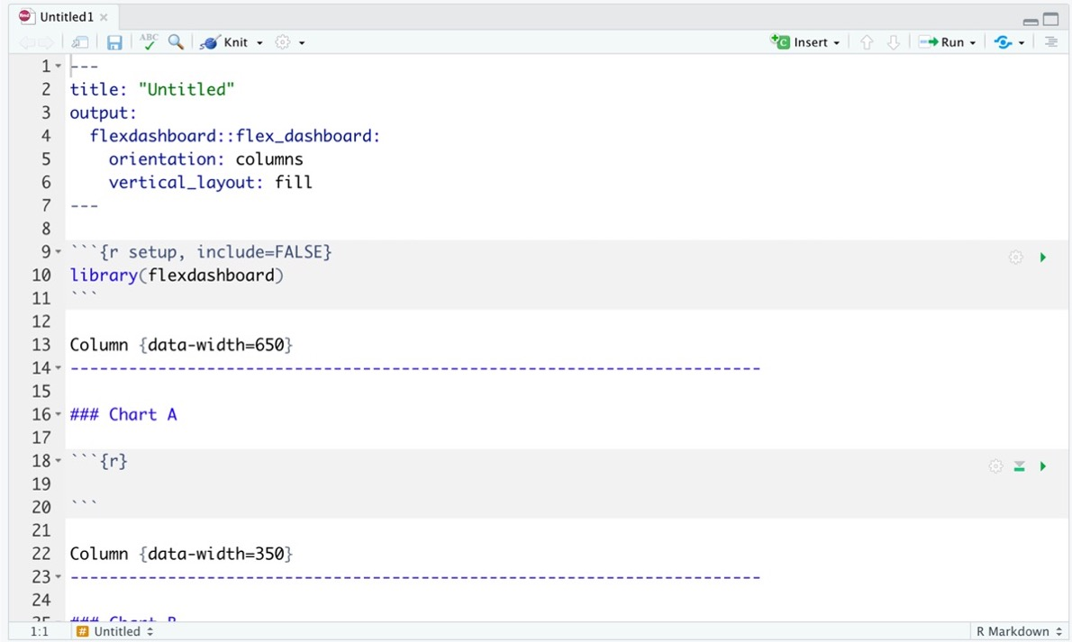
flexdashboard output format
layout page by columns vs rows
fill page and resize vs scroll
define width
title for chart
delimits separate columns
Notes:
R will automatically divide up the available space among the number of visualizations/components you
create within a row (or column), unless you explicitly specify the size of the component. You can also define
the relative sizes of the row and column containers for your dashboard.
we may choose to have the content fill the page vertically, resizing based on the size of the page, or
have content maintain its original height through page scrolling.

Slide 8
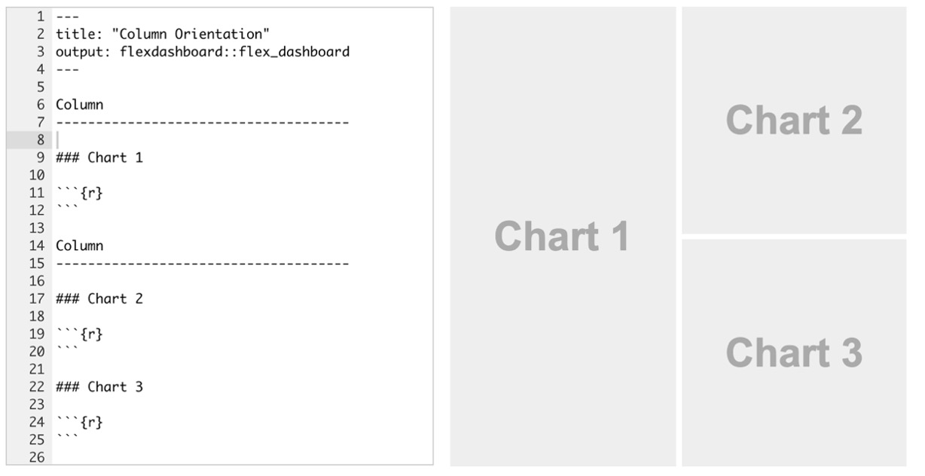

Slide 9
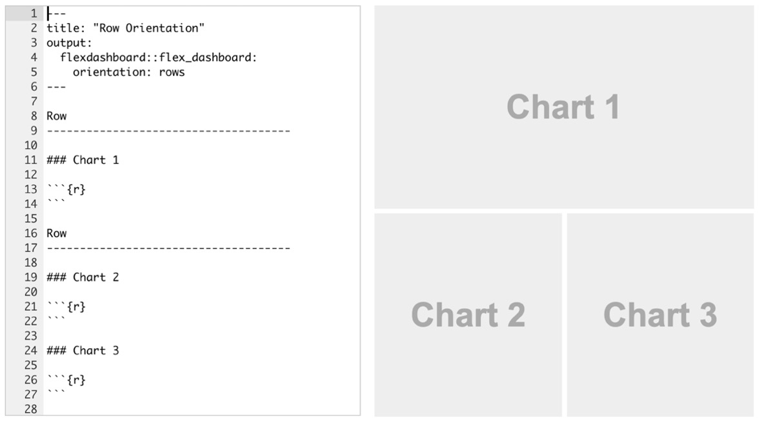

Slide 10
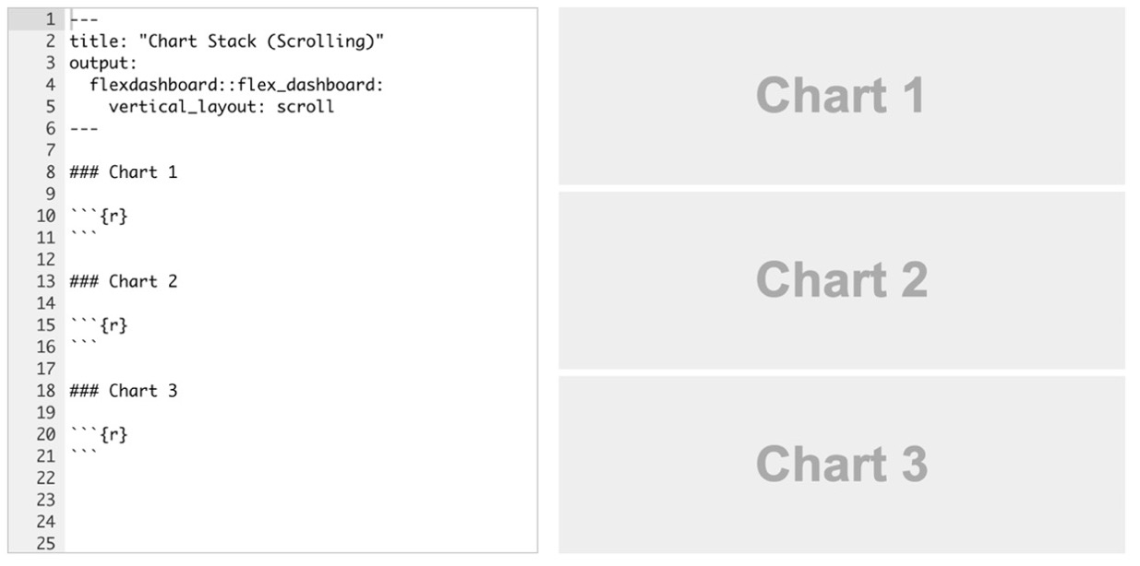

Slide 11
EXERCISE 1
Open “06 – Dashboards with R.Rmd” to work with a draft MS Lab flexdashboard and save it with a new filename.
Run the setup chunk.
Knit the document to see the dashboard output.
Too much information is crunched on the right side. Change the layout from columns to a row orientation. The 2nd and 3rd plots (Ion Ratios and Number Unknown Samples) should appear on the 2nd row.

Slide 12
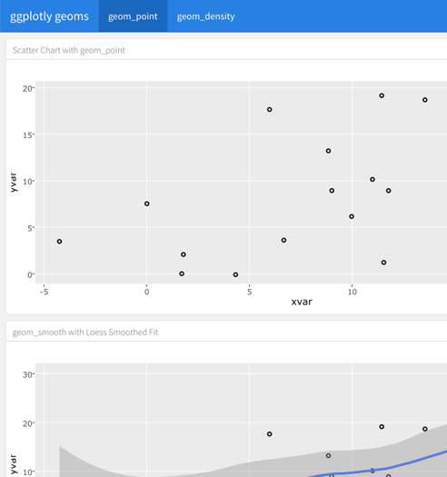
MULTIPAGE FORMATS
delimits separate tabs/pages
Notes:
Tabset and multiple page layouts Sometimes you have too much content for a single page, you want
to create a dashboard with multiple areas of emphasis, or focus or a need to toggle between two components.
In these cases, you are best to use a tabset or multiple page format. Tabsets can be thought of as creating
multiple pages within a row or column. Dashboards with multiple pages can have the same or different
layouts on each page.

Slide 13
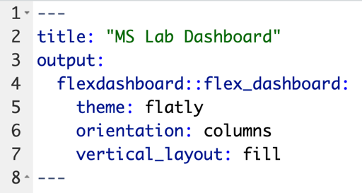
ADDING A THEME
Notes:
Additional customization is possible using themes. Our critical callback dashboard uses the default theme,
cosmo. The available themes are the same ones in the R Markdown package, which were mentioned in our
first session. This blog post shows each theme for comparison. https://www.datadreaming.org/post/r-markdown-theme-gallery/
The theme is set using the theme option in the YAML. Because we are using the default in the sample
dashboard, the theme is not specified.

Slide 14
EXERCISE 2
Modify the YAML of your dashboard to add a theme of your choice.
Include page break syntax to create a two-tab layout.
Knit the dashboard and inspect the changes.

Slide 15
ADDING COMPONENTS TO DASHBOARDS
R graphics and tables
Value boxes
Interactive HTML widgets (plots and tables)

Slide 16
VALUE BOXES
Dashboards commonly include one or more graphics displaying simple values often with an icon and descriptive title.
valueBox()will create this type of component
can be customized via color (static or dynamic), icon, and caption

Slide 17
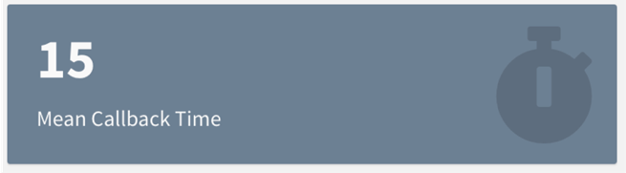
VALUE BOX EXAMPLE
creates value box
data object
valueBox(value = mean_cb_tat, icon = “fa-stopwatch”, caption = “Mean Callback Time”, color = “#708090”)

Slide 18
MAKING PLOTS INTERACTIVE

Slide 19
HTMLWIDGETS FOR R SUPPORT INTERACTIVE VISUALS
Packages using htmlwidgets use R code to call Javascript visualization libraries (http://www.htmlwidgets.org/)
Use one line of code to convert a static plot into an interactive one

Slide 20
PLOTLY PACKAGE CONVERTS GGPLOT WITH A SIMPLE COMMAND
To use Plotly on your desktop install the plotly package using the following command:
install.packages(“plotly”)
Examples of visualizations at Plotly website: https://plotly.com/r/

Slide 21
STORE PLOT AS OBJECT AND ADD ONE LINE TO MAKE IT INTERACTIVE
normal ggplot syntax
plot_name <- ggplot(data = data_frame) +
geom_function(mapping = aes(mappings))
ggplotly(plot_name)
makes plots interactive

Slide 22
EXERCISE 3
Load the plotly package in your dashboard setup chunk
Convert each of the plots into an interactive plot by storing the ggplot in an object and using the ggplotly() function.
Knit the dashboard and hover over the interactive plots.

Slide 23
OTHER OPTIONS FOR INTERACTIVE PLOTS
Other interactive plot packages:
rbokeh
Highcharter
Time series graphs with dygraphs package
Maps with leaflet package

Slide 24
MAKING TABLES INTERACTIVE

Slide 25
INTERACTIVE TABLES WITH ONE LINE OF CODE
DataTables library quickly converts tables into interactive element
DT package in R – to install use:
install.packages(“DT”)
Use datatable() function on a data frame to allow:
Filter number of entries
Search entries
Sort by column

Slide 26
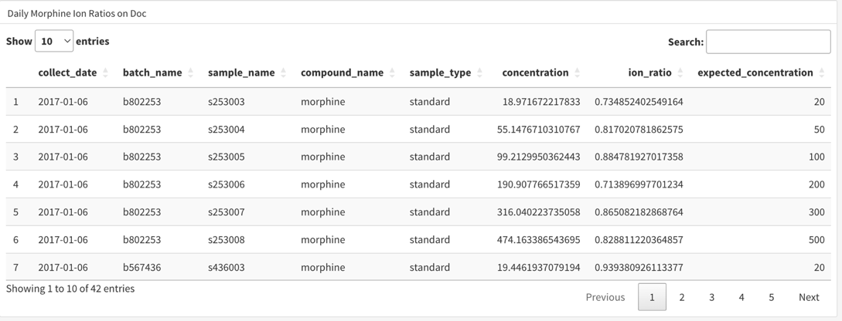
DATATABLE EXAMPLE
datatable(doc_morphine_ion_ratio)

Slide 27
EXERCISE 4
We are going to replace one of our panels of content with an interactive table.
Load the DT package in your dashboard setup chunk
Rename the ion ratio plot panel to “Daily Morphine Ion Ratios on Doc”.
Create a dataframe by filtering sample_peak_batch_standards object to only include results from the instrument named “doc” and collect data.
(hint: to create the dataframe vs SQLite table, use collect())
Display an interactive table that includes the content from the dataframe you created.
Knit the dashboard. Search “s975006” in the search box to confirm the interactive table is working.
Notes:
s975006 is a sample name from 01-08-2017
### Daily Morphine Ion Ratios on Doc
```{r dt}
doc_morphine_ion_ratio <-
sample_peak_batch_standards %>%
filter(instrument_name == "doc") %>% collect()
datatable(doc_morphine_ion_ratio)
```

Slide 28
SUMMARY
flexdashboard is a useful package to create dashboards using R Markdown
Flexible formats and themes make flexdashboards highly customizable
HTML widgets make it easy to add interactivity to plots and tables

Slide 29
LESSON OBJECTIVES
Format a flexdashboard to improve display of multiple plots
Add interactivity to plot and table components of flexdashboards

